Slide 1
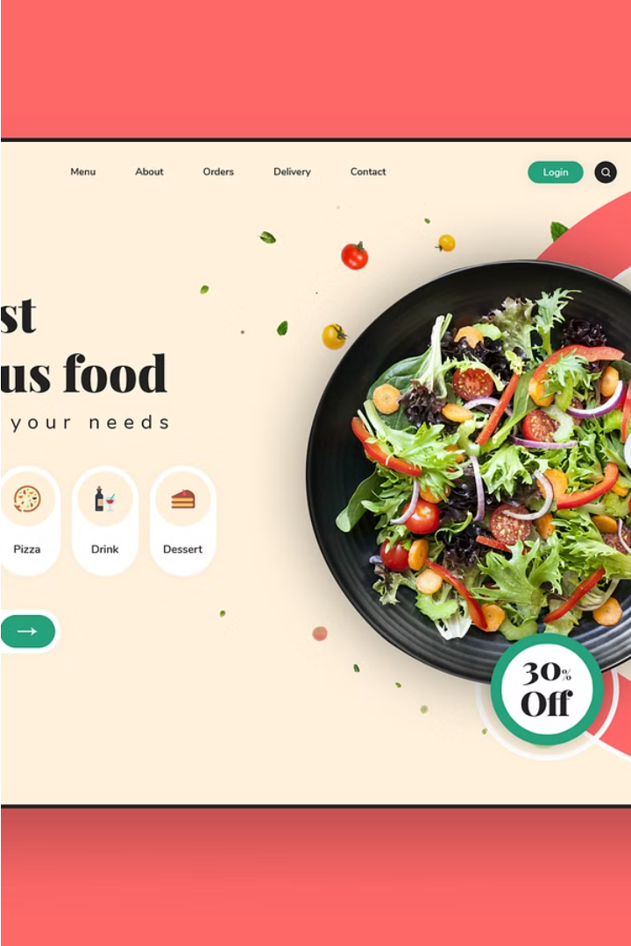
Hotel Food Order Systems
A comprehensive web-based platform that empowers hotels and restaurants to streamline their food ordering process, offering customers a seamless and convenient dining experience.
DBMS Project
Group No. 5 : Anamika Garg IFI2022005
Riya Agarwal IFI2022011
Simaran Maurya IIB2022021
Ayush Saxena IIB2022032

Slide 2
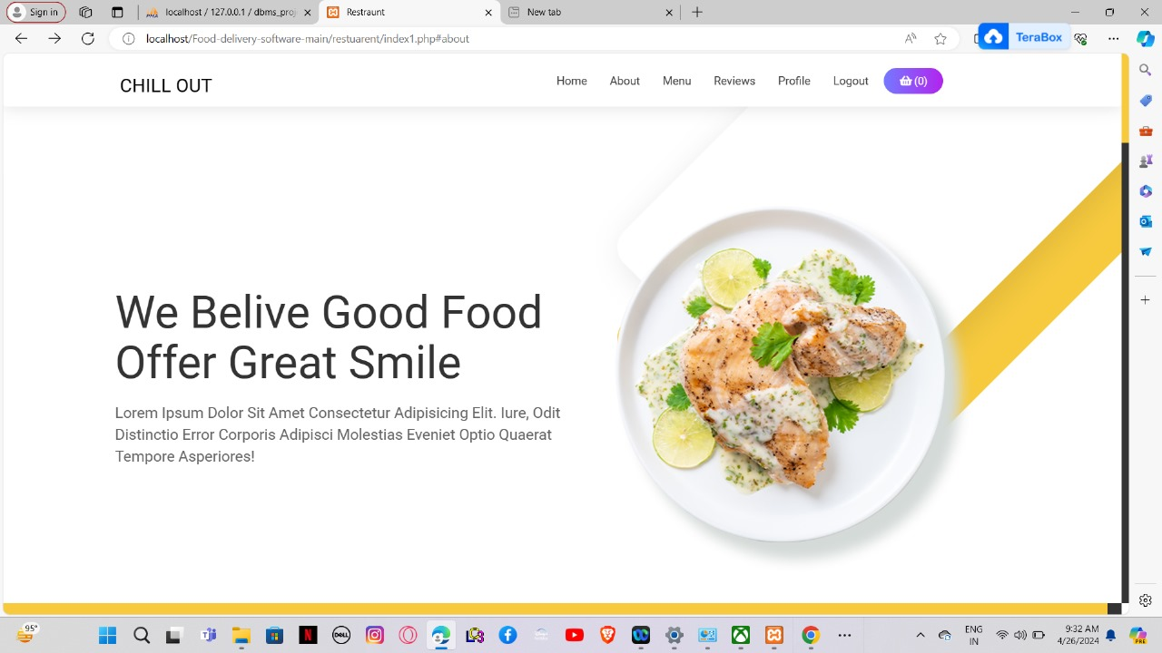
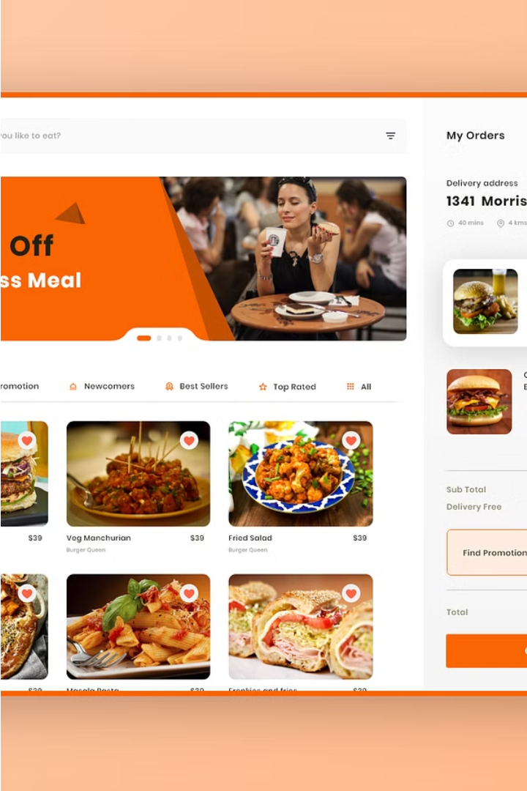
Overview of the Project
The Hotel/Restaurants Food Order Systems project aims to provide a convenient and efficient online platform for customers to order food from their favorite establishments. This web-based application will allow users to browse menus, customize their orders, and even take advantage of home delivery services offered by participating restaurants.
By leveraging modern web technologies, this project seeks to streamline the ordering process, saving customers time and money. The goal is to create a user-friendly interface that enhances the overall dining experience, catering to the needs of both restaurants and their patrons.

Slide 3
Key Features
Online Order Placement
Add Your Cloud Kitchen
Customers can easily browse the menu, customize their orders, and submit orders through a user-friendly online platform.
You can add your own shop, its pictures, menu and all other information.Explore a virtual experience with a diverse menu .
Personalized Recommendations
Loyalty Programs
The system will suggest menu items based on customer preferences and order history, enhancing the dining experience.
Customers can earn rewards and redeem points for future orders, incentivizing repeat business and building brand loyalty.

Slide 4
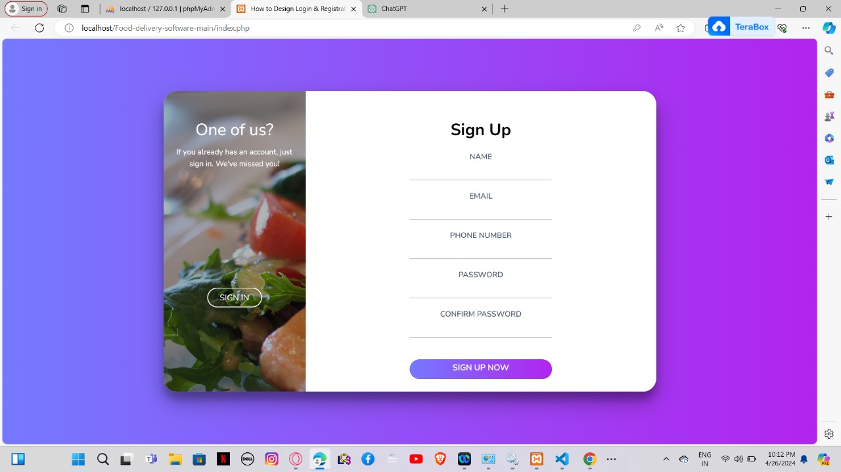
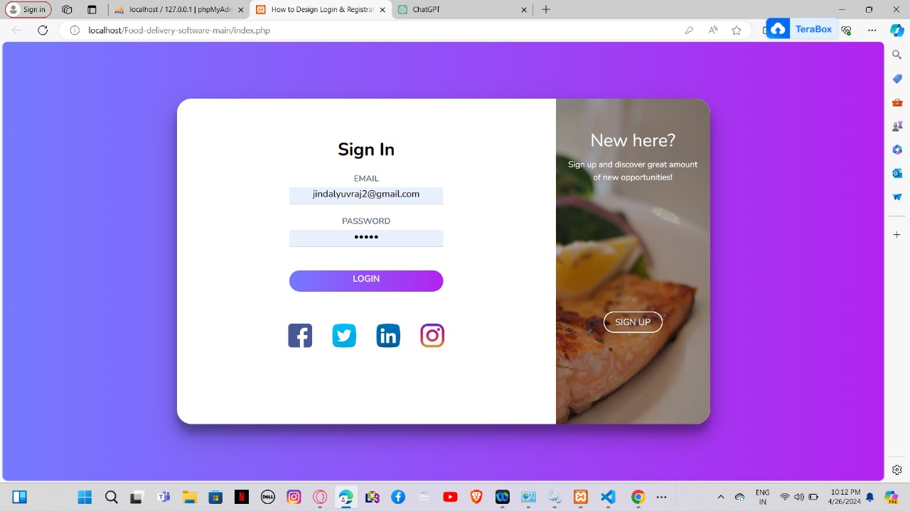
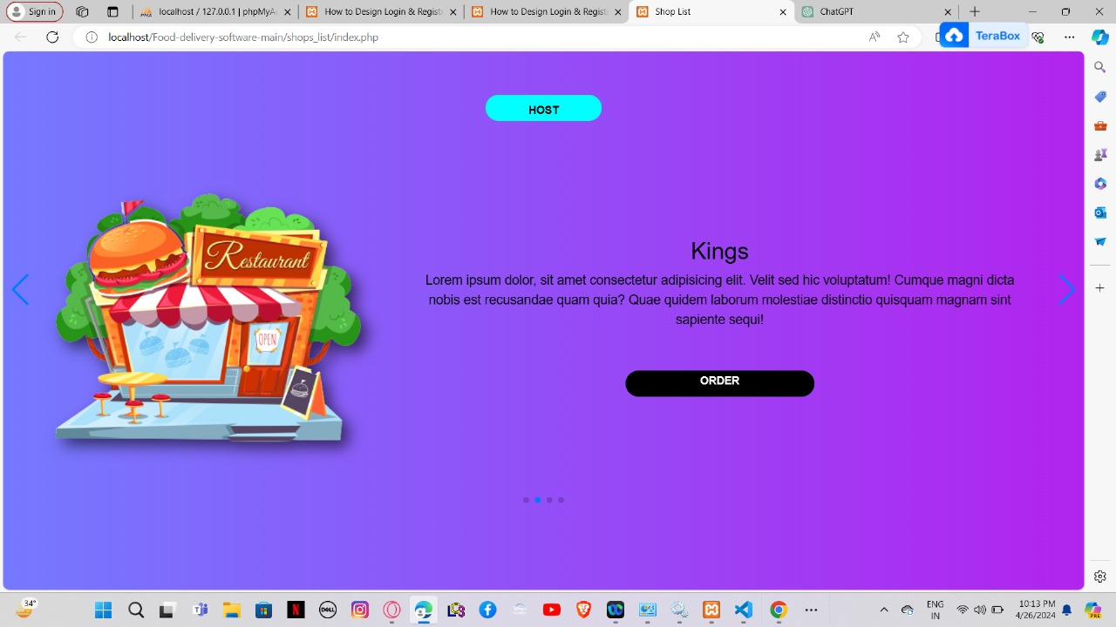
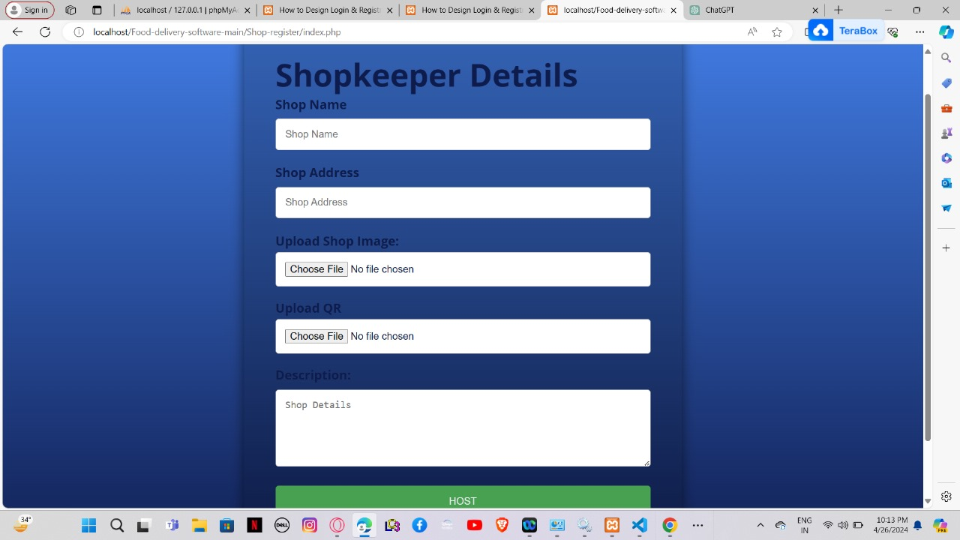

Slide 5
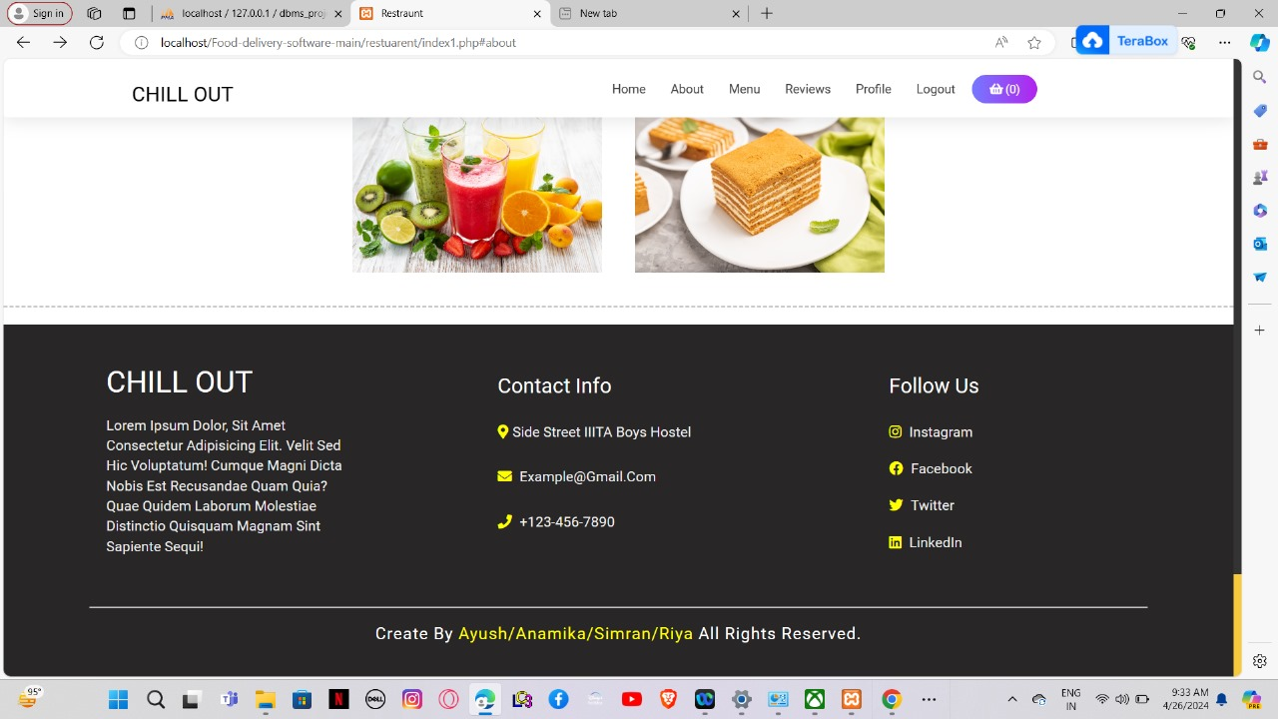
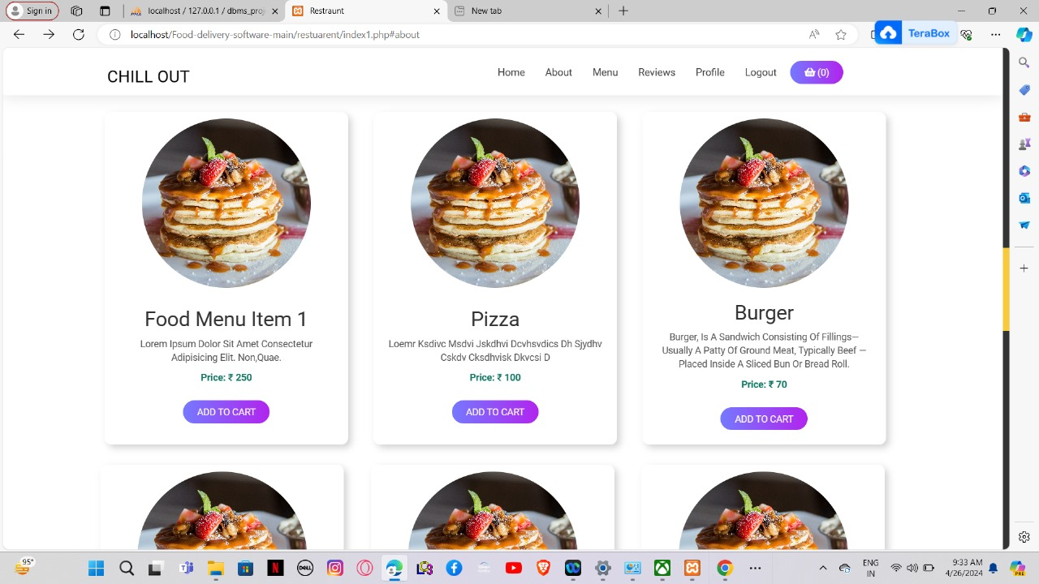
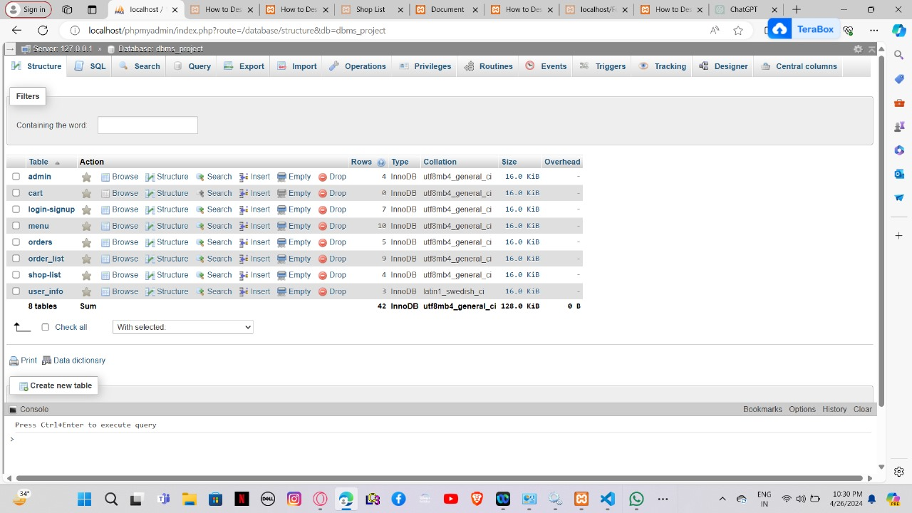
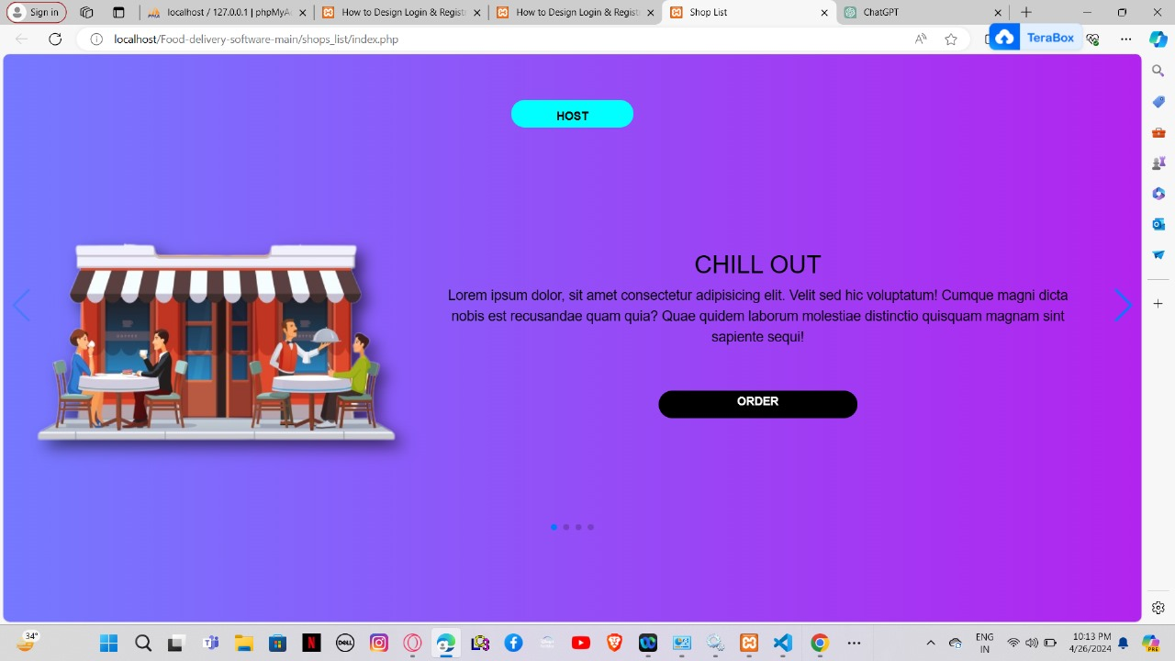

Slide 6
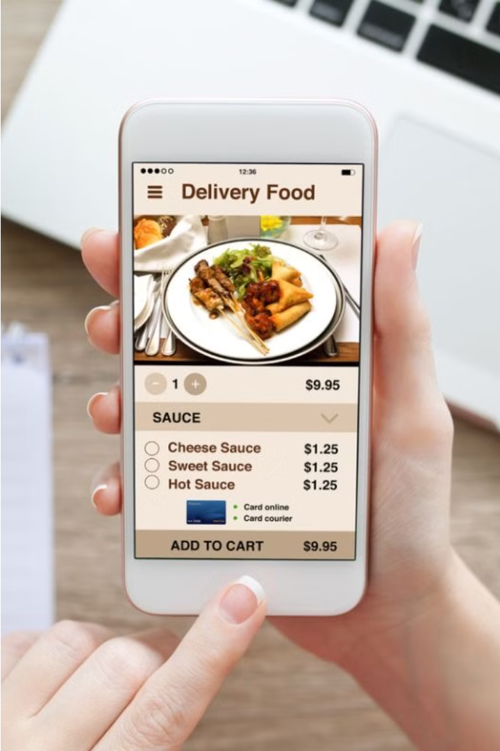
Importance of this project
The Hotel/Restaurants Food Order Systems project is crucial in today's digital landscape, where convenience and efficiency are highly valued by customers. By providing an online ordering platform, this system saves customers time and effort, allowing them to order their favorite meals from the comfort of their homes or offices.
Furthermore, the system streamlines operations for hotels and restaurants, enabling them to manage orders more efficiently, reduce errors, and provide faster service to their patrons. This enhanced customer experience can lead to increased loyalty and positive reviews, ultimately driving business growth.

Slide 7
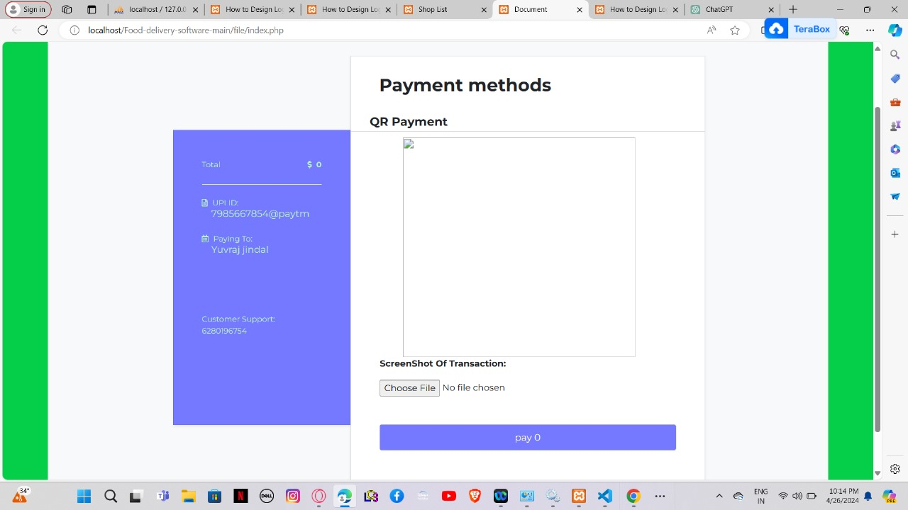
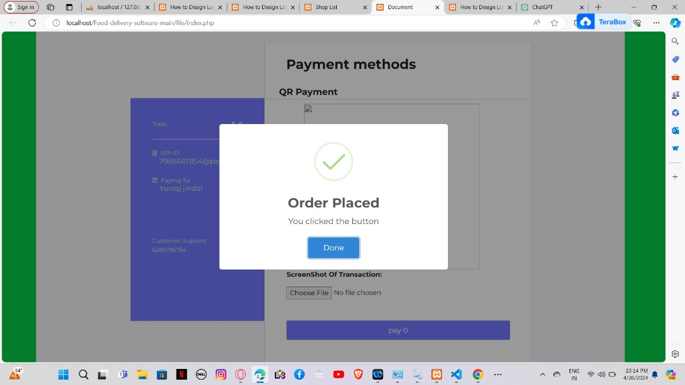
Directly from the cart you can proceed to pay and scan the QR, and your order is placed.

Slide 8
Technology Stack
The Hotel/Restaurants Food Order Systems project will leverage a robust technology stack to deliver a seamless and user-friendly experience. The key technologies involved are:
Database
Oracle
Programming Language
JavaScript, PHP
UI Framework
CSS
Database Connectivity
Xampp (Oracle Instant Client)
These technologies were specifically chosen to provide a reliable, scalable, and feature-rich solution for the hotel and restaurant industry, enabling efficient order processing, delivery management, and seamless customer experience.

Slide 9
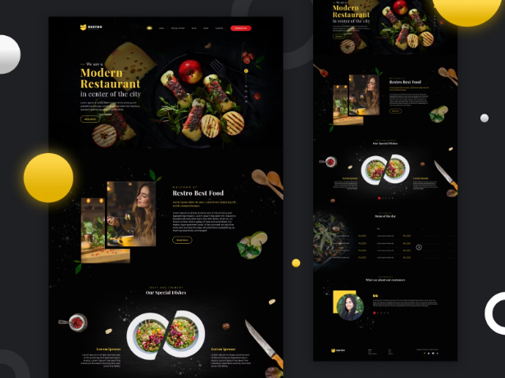
User Interface Design
The user interface for the Hotel/Restaurant Food Order System will be designed to be intuitive and easy to navigate. It will feature a clean and modern look with a focus on usability and accessibility.
Effortlessly integrate new shops and seamlessly navigate through your preferred options with our intuitive swiping feature and seamless integration with payment processing . Experience an enticing menu display, easy order placement, and smooth payment processing, all within a user-friendly interface optimized for desktop and mobile devices.

Slide 10






Functional components of the project
User Registration
Allows customers to create accounts and securely store their personal and payment information.
Menu Management
Enables hotels and restaurants to easily update their menus with new items, prices, and descriptions.
Online Ordering
Lets customers browse menus, customize orders, and submit their requests for pickup or delivery.
Easy to add shops
New shops can easily be added along with its details like pictures, menu, location, etc.
Payment Integration
Securely processes customer payments through various options like credit cards, mobile wallets, and loyalty programs.

Slide 11
Database Design
Relational Database
Entity-Relationship Model
The system will utilize a relational database, such as Oracle, to store customer orders, menu items, and other relevant data.
The database design will follow an entity-relationship model, defining the key entities like "Customers", "Menu Items", and "Orders" and their relationships.
Data Normalization
Scalability and Performance
The database schema will be optimized through data normalization, reducing data redundancy and ensuring data integrity and consistency.
The database design will account for scalability, allowing the system to handle growing numbers of users and orders without performance degradation.

Slide 12




Order Processing and Delivery
Order Placement
Secure Payment
Add To Cart
Feedback and Reviews
Customers can easily place their orders through the intuitive online platform, selecting from a wide range of menu items and customizing their preferences.
The system integrates with secure payment gateways, allowing customers to make their payments safely and conveniently using various options such as credit/debit cards, digital wallets, or bank transfers.
Customers can customize their orders , and easily add things or remove from the cart before order, providing them with transparency and peace of mind.
Customers can share their feedback and ratings on the service, helping the hotel or restaurant to continuously improve their offerings and deliver an exceptional dining experience.

Slide 13
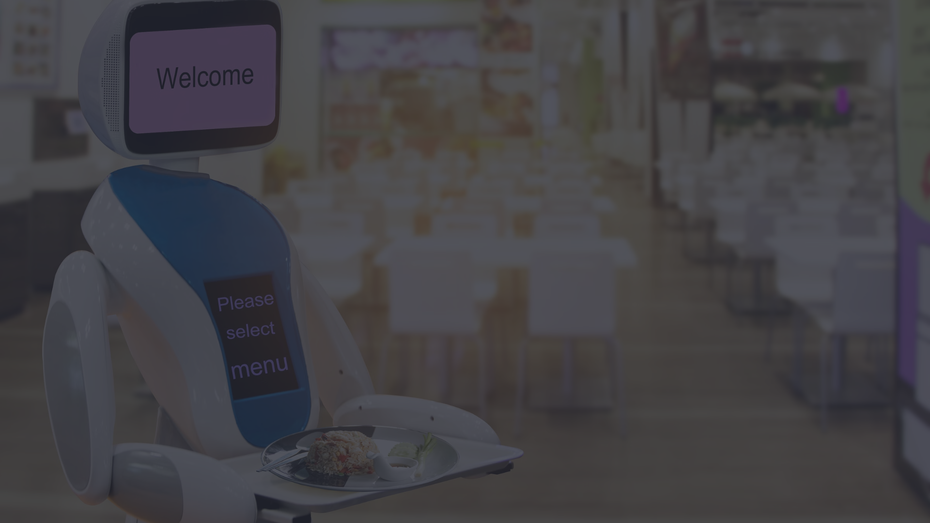
Conclusion and Future Enhancements
Conclusion
1
The Hotel/Restaurants Food Order Systems project has successfully streamlined the ordering process, enabling customers to conveniently place orders and receive timely deliveries.
2
Future Enhancements
Potential future enhancements include integrating mobile app support, implementing AI-powered recommendation systems, and expanding delivery services to reach a wider customer base.
Ongoing Improvements
3
The system will continue to evolve, incorporating user feedback and technological advancements to provide an even more seamless and enjoyable dining experience for customers.

Slide 14
Thank You

